Slide 1
2022 GLOBAL TECHNOLOGY SUMMER ANALYST PROGRAM
CONTAINERIZATION & PIPELINES

Slide 2
EDA TOOL
Problem Statement: To create and deploy an Exploratory Data Analysis application.
GROUP 13
MEMBERS
GOWRI V S PARNAVI KULKARNI
PALAK JAIN RADHIKA WADEKAR
PRAYASH SWAIN SHARVARI PHADKE

Slide 3
CONTENTS
Project specifications
Introduction and aims
Tech stack and technologies used
Flow and demo
Scope of improvement
Key Takeaways
Conclusion

Slide 4
Introduction and Aims
To design an EDA tool which can be used by data scientists, data engineers, AI/ML/DevOps engineers, developers.
Primary purpose: to present data inside a dataset in easy-to-understand format making feature-extraction easier.

Slide 5
Reasons for choice & role of technologies
Development phase:
Why Python?
Very effective while dealing with multimedia data, makes interaction with other technologies easier
Why Flask?
Lightweight yet robust framework
Deployment phase:
Why Jenkins?
CI/CD pipeline for building, testing and deploying
Deployment on Openshift
Why Docker?
To containerize the application, and create an easily accessible docker image out of it

Slide 6
Techstack and technologies
Backend: Python & Flask
Frontend: HTML
GitHub
Jenkins
Docker
OpenShift

Slide 7
Flow
Python code development (app.py), including all the libraries required.
Converting the python code to a flask application.
Creating Dockerfile and Jenkinsfile for the files.
Uploading the application to github followed by carrying out the build process in Jenkins.
Input: dataset csv file, name of ‘Class’ column
Outputs: properties and data visualizations about every column in dataset.

Slide 8
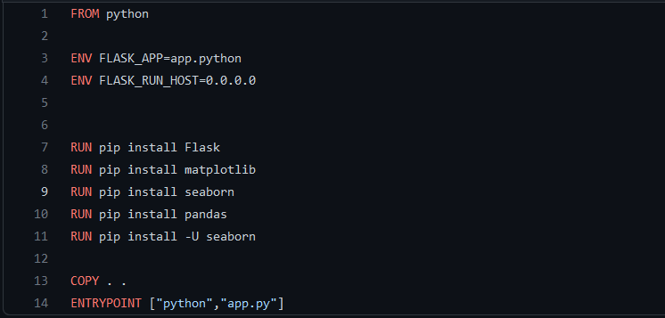
Code
Dockerfile

Slide 9
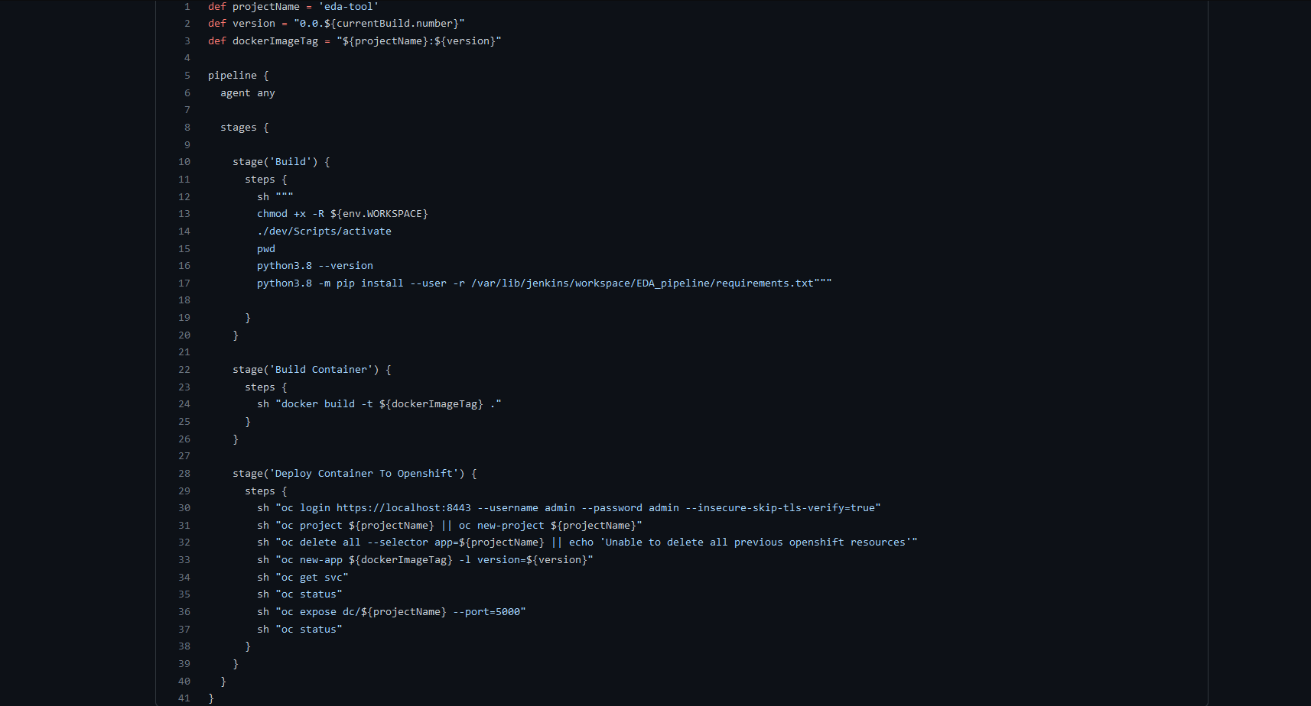
Code
Jenkinsfile

Slide 10
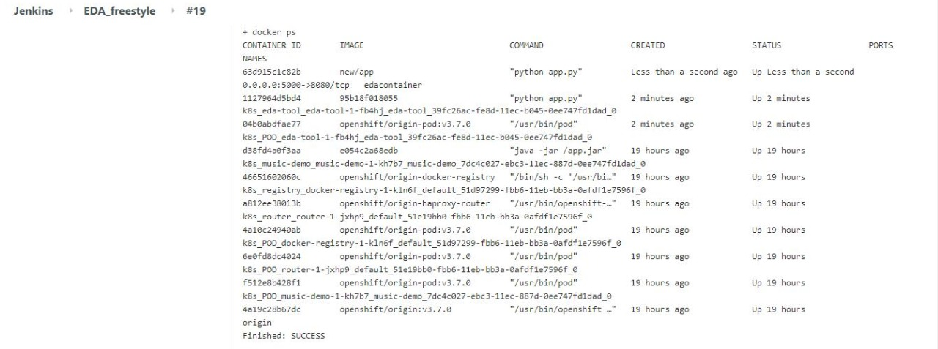
Demo
Jenkins Freestyle Project

Slide 11
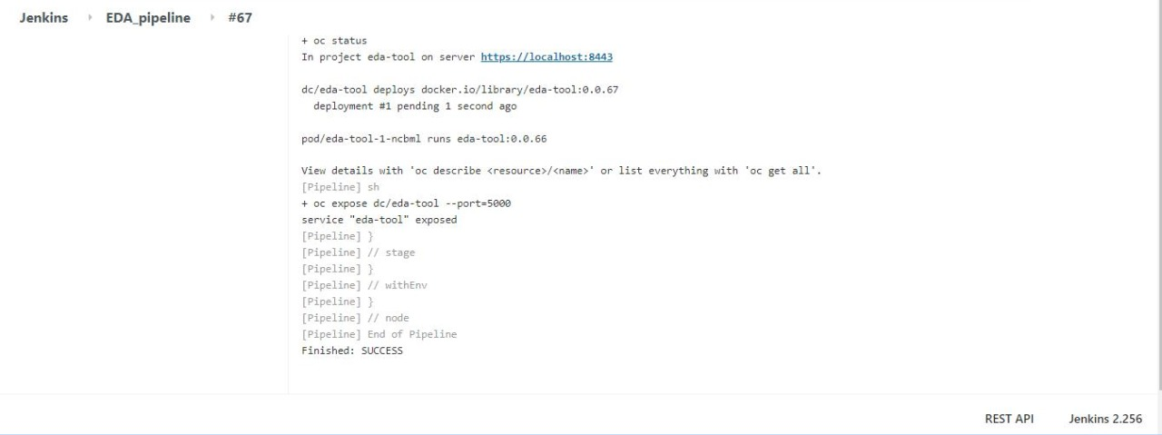
Demo
Jenkins Pipeline Build

Slide 12
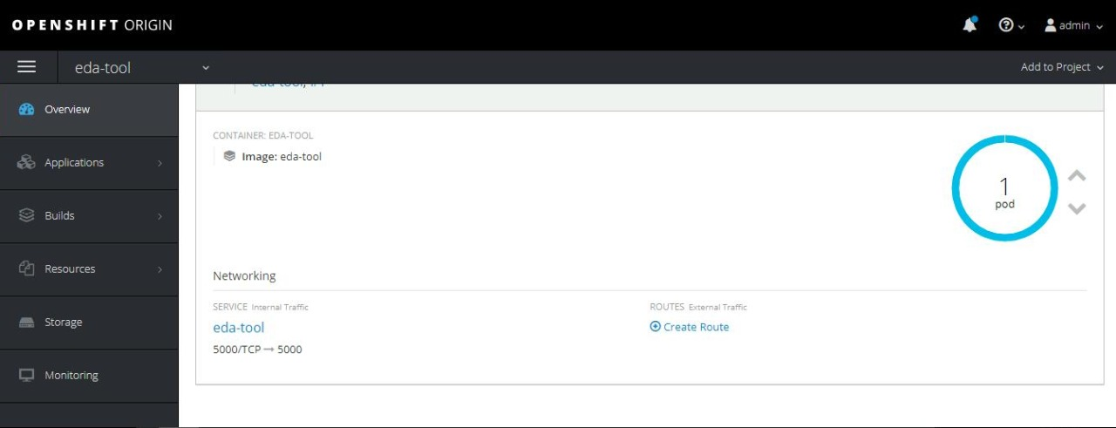
Demo
Openshift Dashboard

Slide 13
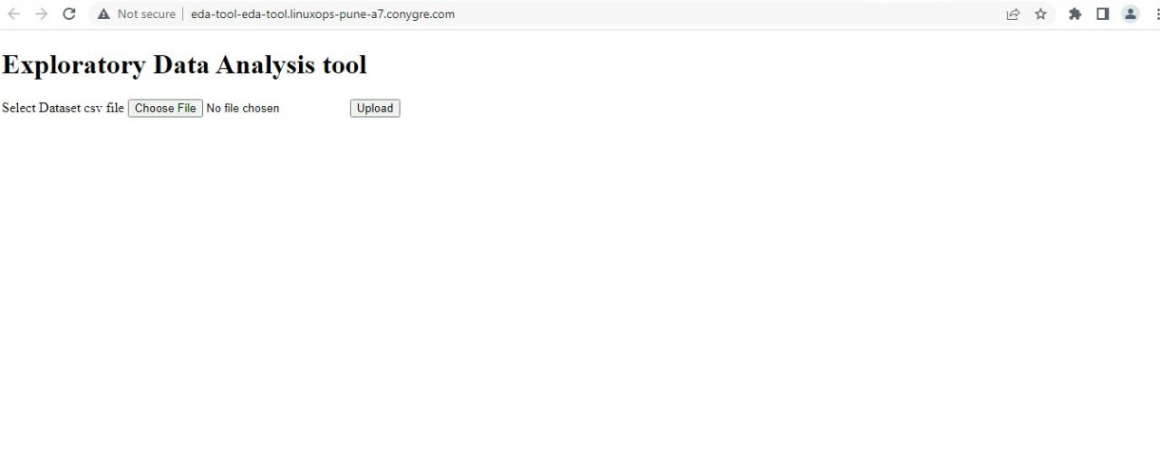
Demo
Openshift Route creation successful

Slide 14
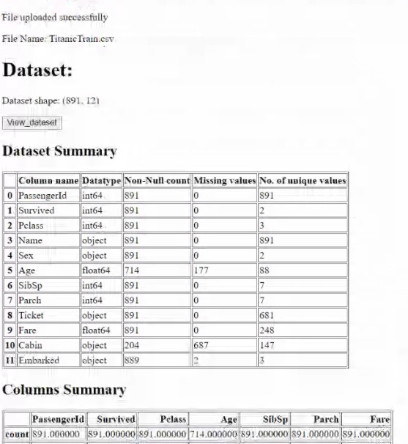
Demo

Slide 15
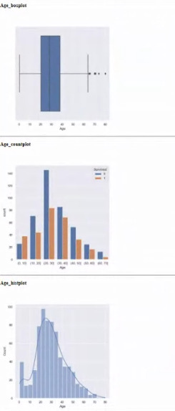
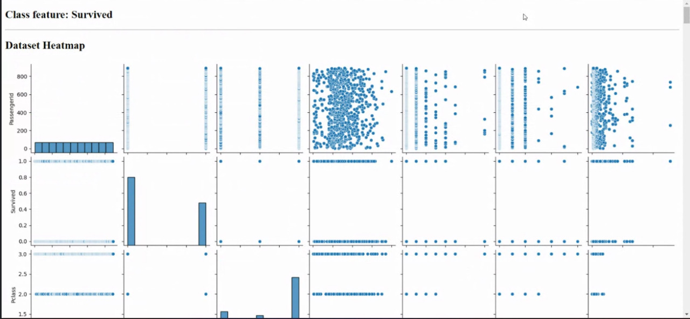
Demo

Slide 16
Scope of improvement
Frontend of the application can be improved with CSS and added functionalities.
Visualization options can be further improved.
Add a test stage to the Jenkinsfile.
Schedule the build process.

Slide 17
Key Takeaways
Getting familiarized with modern technologies like cloud.
Trying hands on AWS.
Got a chance to explore Git, Bitbucket, Docker and Jenkins.
Introduction to containerization, dockerization, freestyle project, pipelining, to name a few.
Kahoot! improving reaction times :P

Slide 18
Conclusion
Lastly and most importantly, we would like to express our gratitude towards all the instructors for the NEUEDA Training Program. Thanking you for an insightful training session and for being available for addressing our queries. We would like to thank you for giving us an opportunity to put up into practice, the skills you introduced us to.

Slide 19
THANK YOU!

